Slide 1
Data Tree Online Course
Notes:
Planning for data management

Slide 2
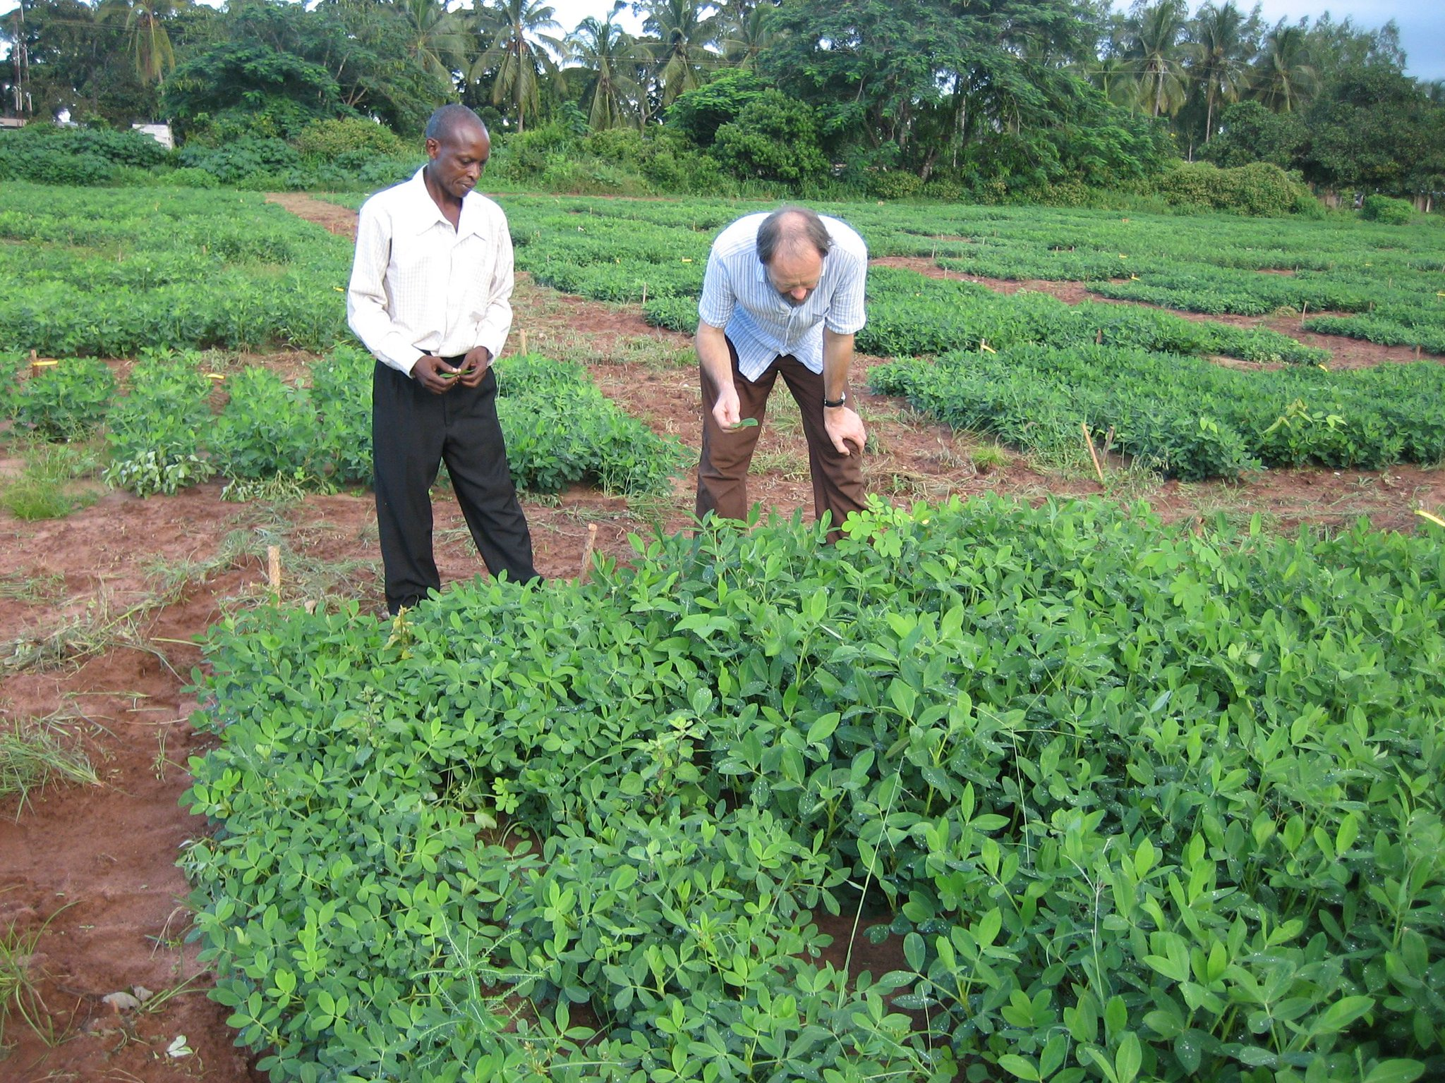

Slide 3
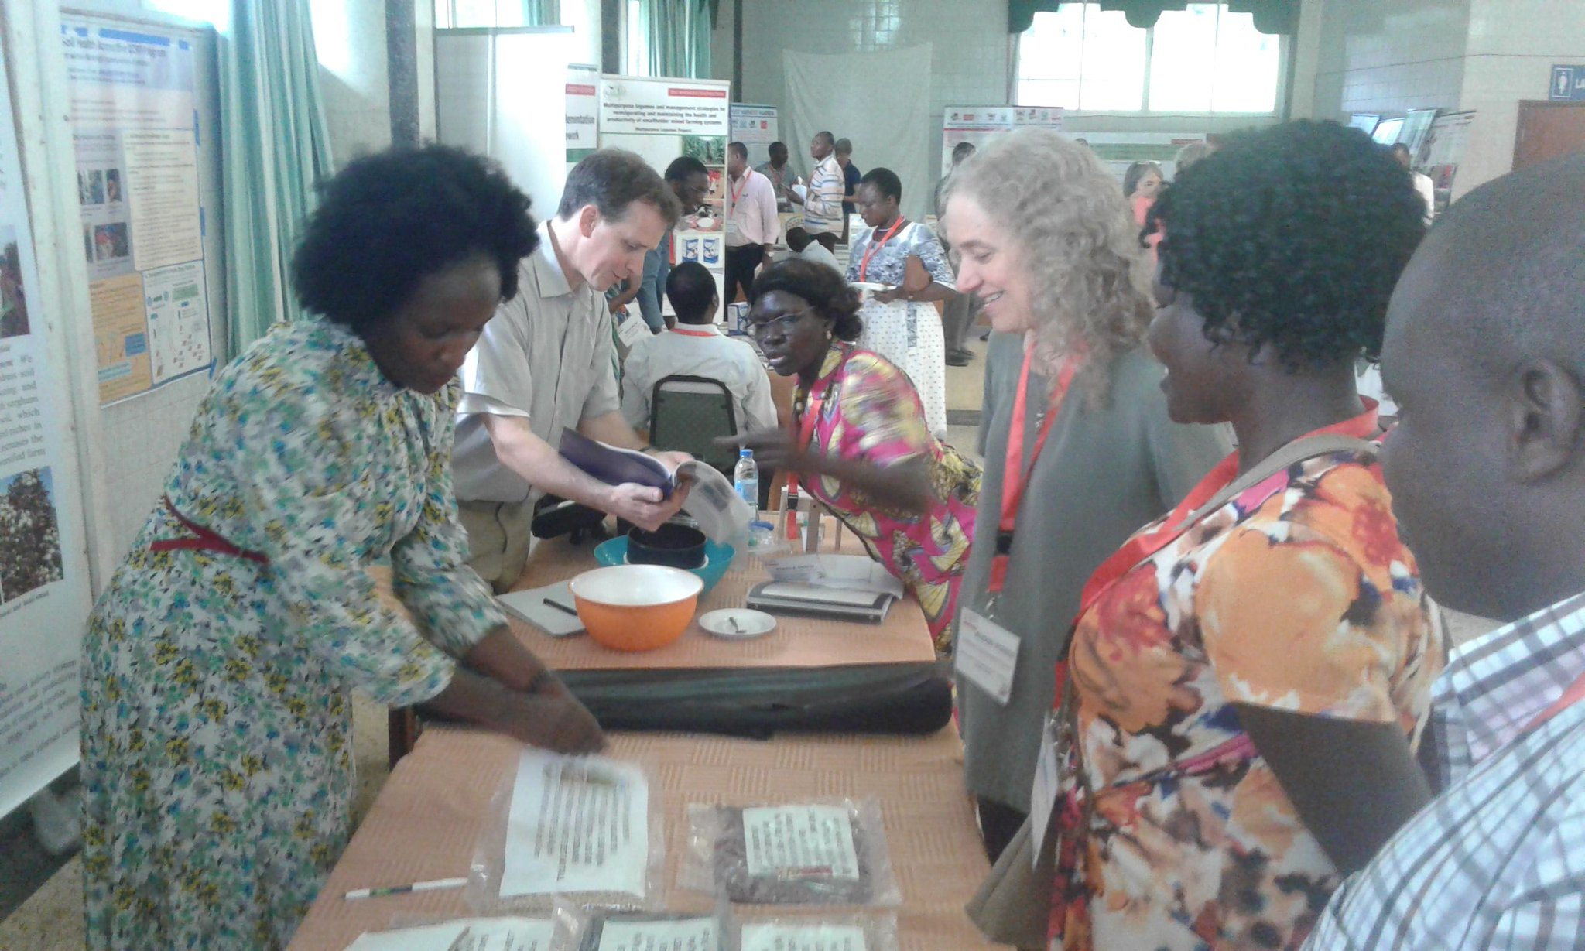

Slide 4
Why Data Tree?
Bring together information about NERC Data Centres
Broad overview of many Data / Data Management topics
Purpose of your data!
Notes:
So why Data tree?
The easy answer is “because Nerc wanted to fund it”, That’s not the full story, but it is where we started.
There are already a lot of great Data Management resources and guides focused at researchers, (Mantra, DMPonline and DCC materials, many institutions have at least some support / guidance on DM matters).
NERC’s Data centres have some resources / help available, but not always easy to find.
So: one starting point for Data Tree was wanting to bring together a lot of information and guidance about how PhD / EcRs, funded by NERC can make use of the DCs.
More than that - wanted to have a resource useful to everyone involved in research. Excuse to bring together information from different sources / people, so researchers coming to the course would be exposed to a lot of different data-related topics.
We needed to go beyond ‘just’ data management. What is the reason for good data management? Purpose of your data?

Slide 5
The Course
1. Context
4. Analysis
6. Policy
2. Practicalities
5. Visualisation
7. Business
3. NERC
8. Media and Public
Data Management
Data Application
Engaging End Users
Notes:
The course is split into 3 sections:
1st section is the core ‘Data Management’ content - this is where you’d find what you might typically expect from a DM course.
Topic 1 discusses a lot of general topics about working with data in the context of research:
- core terminology;
- research data life cycle
- issues around open data - sharing data and ‘FAIR’
- policy;
- touch on a few other things like reproducibility, ethics, publishing.
Topic 2 focuses on how you actually handle your data.

Slide 6
Course Content
Notes:
Different types of content in the course.

Slide 7
Notes:
Main content is a set of interactive presentations (mainly text / visuals), which guide you through the key learning points and test understanding as you go.
We’ll also be adding downloadable versions of the presentations to make it easier to quickly reference particular sections.

Slide 8
Notes:
Other content - video; audio / animated clips from interviews; links to external resources and added documentation.

Slide 9
Using the course
Designed to be modular
Complete the bits you want / need
No timetable
(No facilitation…)
Notes:
Flexible content to meet your needs.

Slide 10
What’s Next?
First 3 modules available this evening
Full course available 18th July
Notes:
Flexible content to meet your needs.

Slide 11
Notes:
Thank you.

